Slide 1

DIGITAL DESIGN AND COMPUTER ORGANIZATION LABORATORY
UE19CS206
(0-0-2-1-1)
Computer Science and Engineering

Slide 2

DDCO Lab: Tools / Languages
Icarus Verilog Simulator
GTKWave Waveform Viewer
Department of Computer Science and Engineering

Slide 3

iVerilog Installation
DIGITAL DESIGN AND COMPUTER ORGANISATION LABORATORY
What is Icarus Verilog?
Icarus Verilog is a Verilog simulation and synthesis tool.
Icarus Verilog is available for Linux, Windows and Mac OS X. It is released under the GNU General Public License.
It operates as a compiler, compiling source code written in Verilog (IEEE-1364) into a target format.
Department of Computer Science and Engineering

Slide 4
iVerilog Installation
DIGITAL DESIGN AND COMPUTER ORGANISATION LABORATORY
Installation on Ubuntu (tested on 13.10)
sudo apt-get update
sudo apt-get install iverilog
sudo apt-get install gtkwave
Installation on Windows
Download and run the iverilog-0.9.7_setup.exe installer from http://bleyer.org/icarus.
Accept all of the default choices as you click through the installation.
Make sure the installation was successful by opening up the command prompt (hit Windows+R and run cmd) and entering the command iverilog
Department of Computer Science and Engineering

Slide 5
iVerilog Installation
DIGITAL DESIGN AND COMPUTER ORGANISATION LABORATORY
What is GTKWave?
GTKWave is an open-source waveform viewer that displays VCD (and other) files graphically .
GTKWave is a fully featured GTK+ based waveform viewer, which is used to view the simulated output of the Verilog code.
Department of Computer Science and Engineering

Slide 6
Introduction to Verilog
DIGITAL DESIGN AND COMPUTER ORGANISATION LABORATORY
HDL Overview
Hardware description languages (HDL) offer a way to design circuits using text-based descriptions
HDL describes hardware using keywords and expressions.
Logic expressions, truth tables, functions, logic gates
Two primary hardware description languages
VHDL
Verilog
Department of Computer Science and Engineering

Slide 7
Introduction to Verilog
DIGITAL DESIGN AND COMPUTER ORGANISATION LABORATORY
Popularity of Verilog
General-purpose
Easy to learn, easy to use
Similar in syntax to C
Supported by most popular logic synthesis tools. There are four levels of abstraction in Verilog.
Circuit Level
Gate Level
Data Flow Level
Behavioural Level
In Verilog HDL a module can be defined using various levels of abstraction.
Department of Computer Science and Engineering

Slide 8

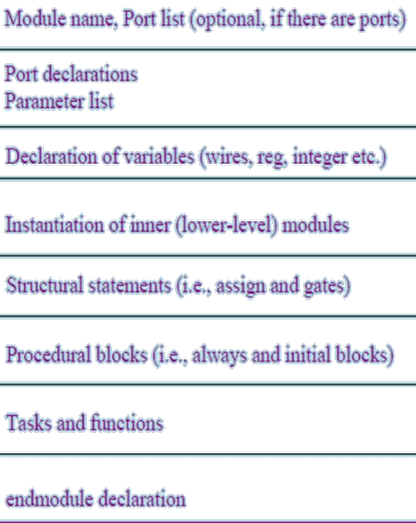
Verilog Language Basics
DIGITAL DESIGN AND COMPUTER ORGANISATION LABORATORY
Module Declaration
General definition
module module_name circuit_name ( port_list );
port declarations;
…
variable declaration;
…
description of behavior
endmodule
Department of Computer Science and Engineering

Slide 9
Verilog Language Basics
DIGITAL DESIGN AND COMPUTER ORGANISATION LABORATORY
Module Definition
Module are the building blocks of Verilog designs
Describes the functionality of the design
States the input and output ports
module followed by circuit name and port list
Each port is either an input or output
Always terminates with endmodule
All code are contained in modules
Modules cannot be contained in another module
Can invoke other modules
Department of Computer Science and Engineering

Slide 10

Verilog Language Basics-Logic Gates
DIGITAL DESIGN AND COMPUTER ORGANISATION LABORATORY
/* A simple AND gate File: and2.v */
module andgate (y,a, b,); input a, b;
output y;
assign y = a & b;
=y
endmodule
a | b | y= a.b
0 | 0 | 0
0 | 1 | 0
1 | 0 | 0
1 | 1 | 1
Department of Computer Science and Engineering

Slide 11
Verilog Language Basics-Logic Gates
DIGITAL DESIGN AND COMPUTER ORGANISATION LABORATORY
/* testbench for AND gate
module and_test;
reg a, b; wire y;
and_test(y,a,b); initial
begin
#0 a=0;b=0;
#5 a=0;b=1;
#10 a=1;b=0;
#15 a=1;b=1;
end initial begin
File: and2_tb.v */
$monitor($time, "a=%b, b=%b, y=%b", a ,b ,y); end
initial begin
$dumpfile ("and2_test.vcd");
$dumpvars (0, and_test); end
endmodule
Department of Computer Science and Engineering
Notes:
$dumpfile directive to create a file that contains the dumped waveforms. Use the $dumpvars directive to define the scope of the dump.
https://www.referencedesigner.com/tutorials/verilog/verilog_62.php
$dumpvars(<levels> <, <module_or_variable>>* );
When level is set to 0, and only the module name is specified, it dumps ALL the variables of that module and all the variables in ALL lower level modules instantiated by this top module.
if we wish to dump the variables only in the top module but not the modules instantiated below it, we could have 1 as its first argument as in $dumpvars(1, toptestbench_module);

Slide 12
Verilog Language Basics
DIGITAL DESIGN AND COMPUTER ORGANISATION LABORATORY
Steps for execution
iverilog –o test1 and2.v vvp test1
and_tb.v
gtkwave and2_test.vcd
Department of Computer Science and Engineering
Notes:
Vvp- Verilog virtual processor

Slide 13
Verilog Language Basics
DIGITAL DESIGN AND COMPUTER ORGANISATION LABORATORY
Symbols:
AND ----- &
OR ------ |
Not----- ! XOR---- ^
Department of Computer Science and Engineering

Slide 14
Verilog Program-Simple Circuit
DIGITAL DESIGN AND COMPUTER ORGANISATION LABORATORY
Next, execute the compiled program
Running the simulation
To run the simulation, type
vvp simple and hit enter.
You should see output something like:
VCD info: dumpfile simple.vcd opened for output.
A is 1010, B is 0011. A is 1100, B is 0101.
Viewing the output
You can use the GTKWave program to
output.
view the
At the terminal type gtkwave simple.vcd results of your simulation.
to view the
Department of Computer Science and Engineering

Slide 15

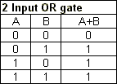
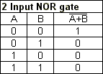

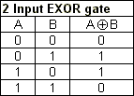

LAB Assignment 1
Verilog Language Basics-Logic Gates
DIGITAL DESIGN AND COMPUTER ORGANISATION LABORATORY
Department of Computer Science and
Engineering

Slide 16



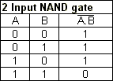
DIGITAL DESIGN AND COMPUTER ORGANISATION LABORATORY
Verilog Language Basics-Logic Gates
Lab Assignment 1-Logic Gates
Department of Computer Science and

Slide 17
THANK YOU
Team DDCO
Department of Computer Science and Engineering

